Slide 1
Google BTC Ticker Demo
Kyle Elmore

Slide 2
Overview
Set Bitcoin tickers to update the price of within a Google sheet
Using Kraken Market’s API, download prices
Update columns within Google Sheet to reflect prices

Slide 3
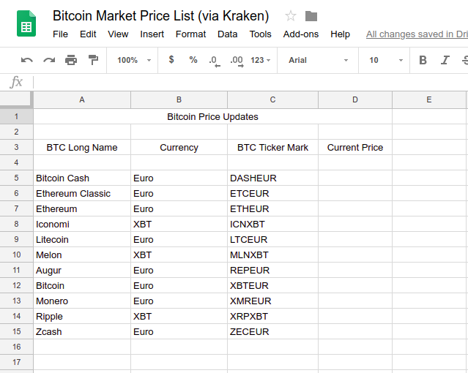
BTC Download Demo
Set tickers to download on C column in Google Sheet

Slide 4
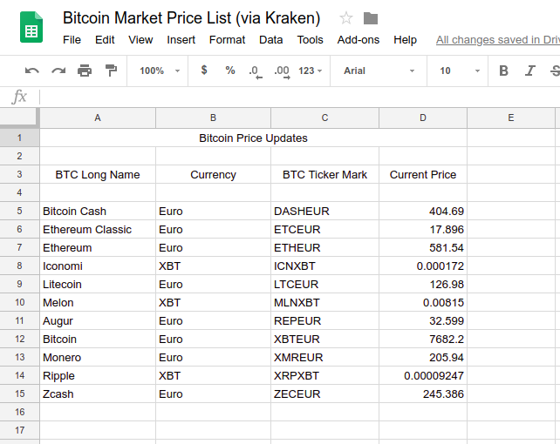
Spreadsheet filled out
Prices are filled from Google script

Slide 5
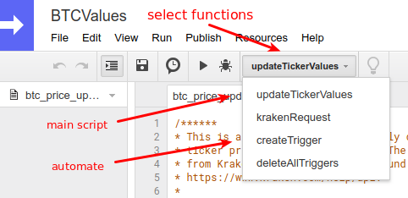
Running the script
Select which function you’d like to run
updateTickerValues = Run script
createTrigger = Run script automatically every minute (can be changed)
deleteAllTriggers = Stop automatic run of script

Slide 6
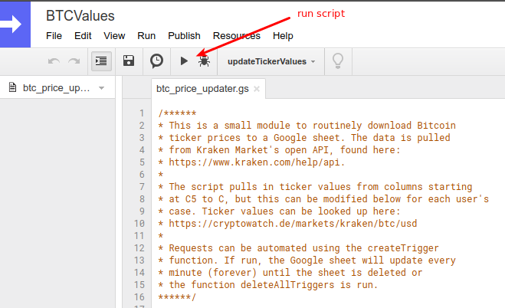
Running the script
Once the function is chosen, run it and watch the magic happen

Slide 7
Links
Github: https://github.com/kelmore5/bitcoin-price-updater
Shared Google Sheet: https://docs.google.com/spreadsheets/d/1aGEiwC4Xu0AjfJZHydHrtq9XWuXme05gdUNUNnr5Wxw/edit?usp=sharing

